Slide 1
Project Development Workflow
Using Git, GitHub, and SourceTree

Slide 2
Best Practices
origin/master should never be broken
You should always have full confidence that deploying to the remote won’t break anything
Develop features and bug fixes in side branches

Slide 3
Your View of the Project
v 3.0
v 2.0
v 1.0
initial
abc01
master
origin/master
stable

Slide 4
Your Daily Routine (1) (Minor / Safe Modifications)
Fetch and pull from remote*
Make, stage, and commit changes
Fetch and pull again (only when necessary)*
Push to remote
* resolve potential conflicts

Slide 5
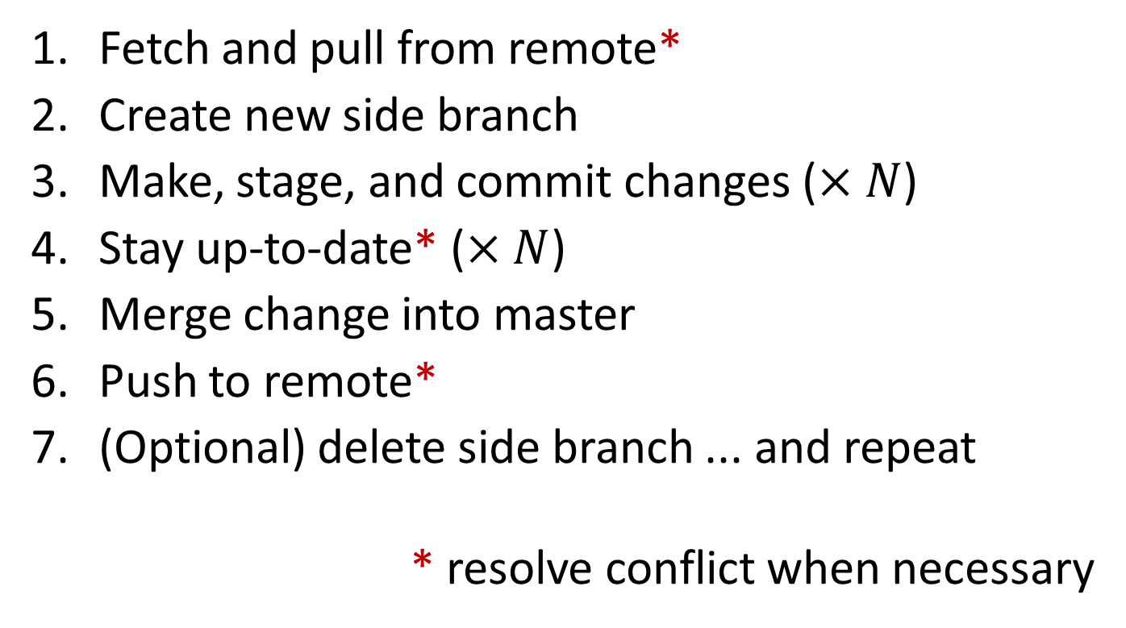
Your Daily Routine (2) (Major / Risky Developments)
Fetch and pull from remote*
Create new side branch
Make, stage, and commit changes ($×N$)
Stay up-to-date* ($×N$)
Merge change into master
Push to remote*
(Optional) delete side branch ... and repeat
* resolve conflict when necessary

Slide 6
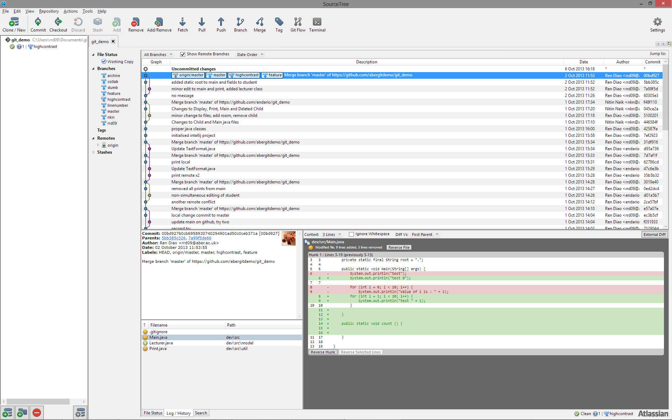
SourceTree Interface

Slide 7
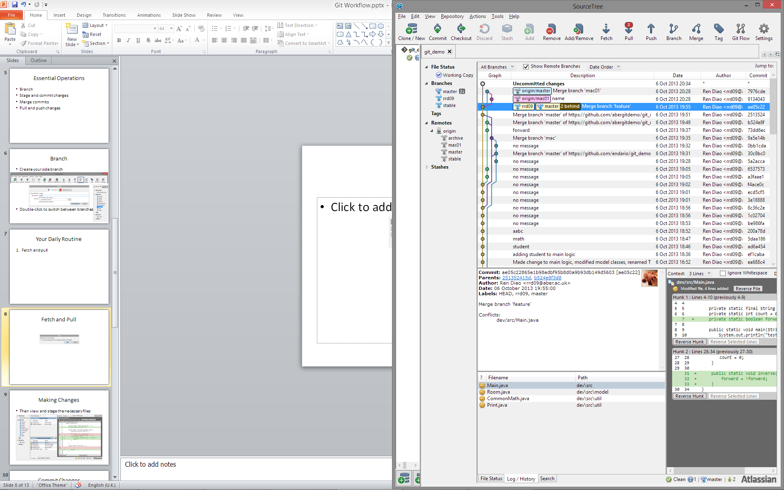
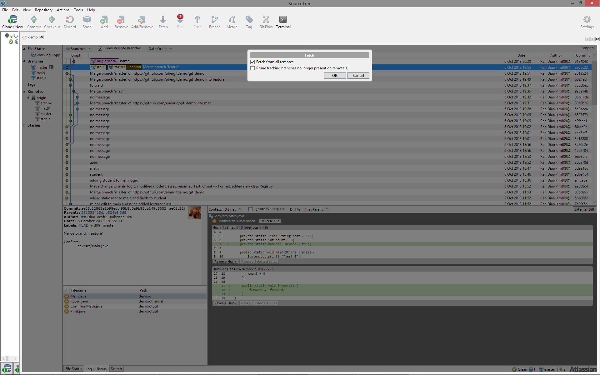
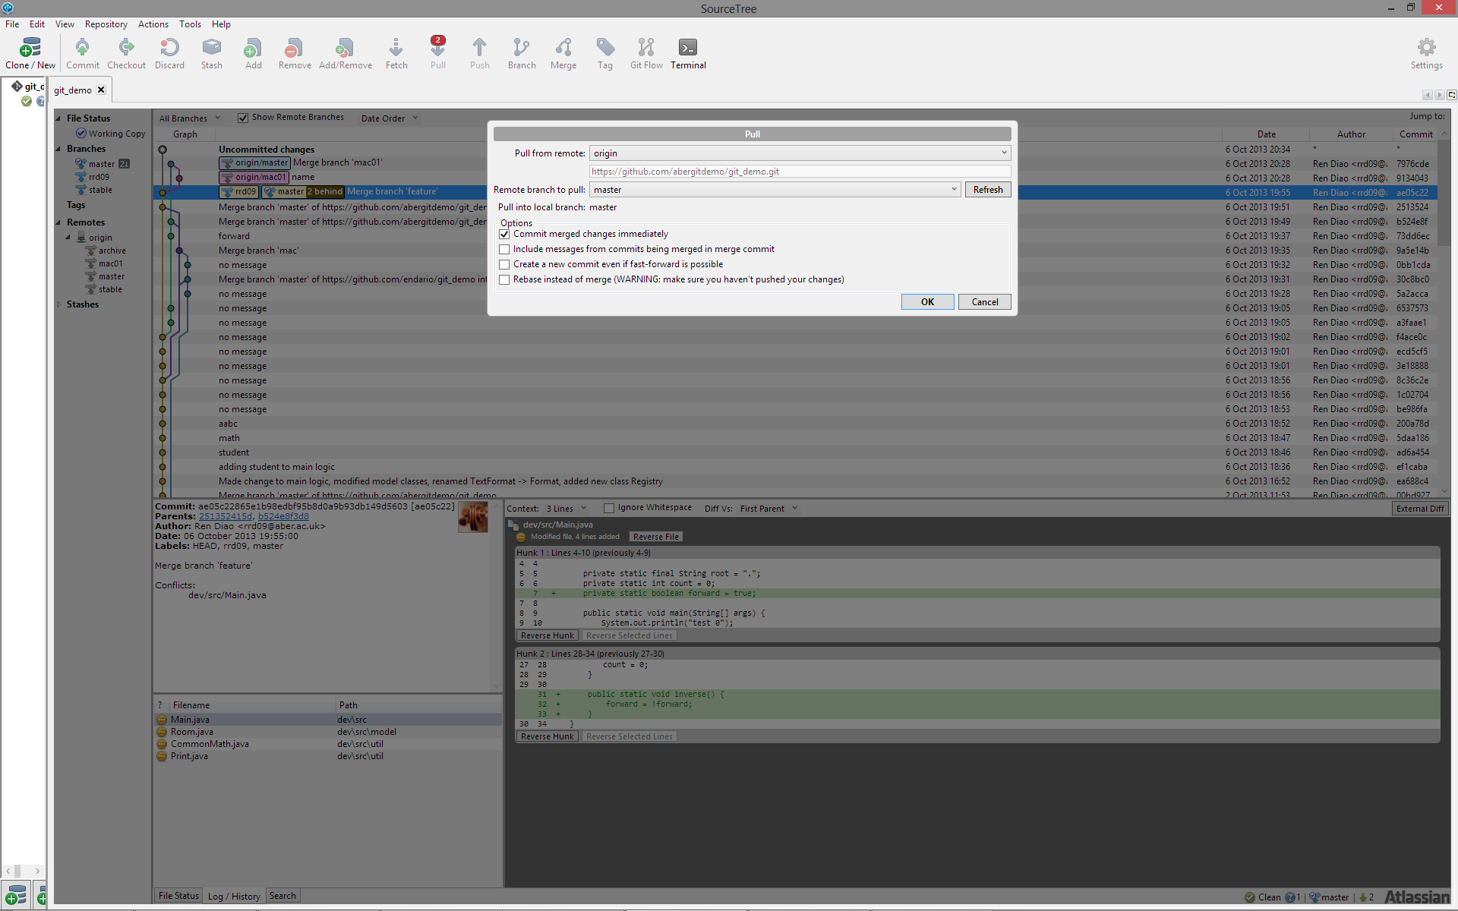
1. Fetch and Pull* (update master)
Switch to master (if not already on)

Slide 8
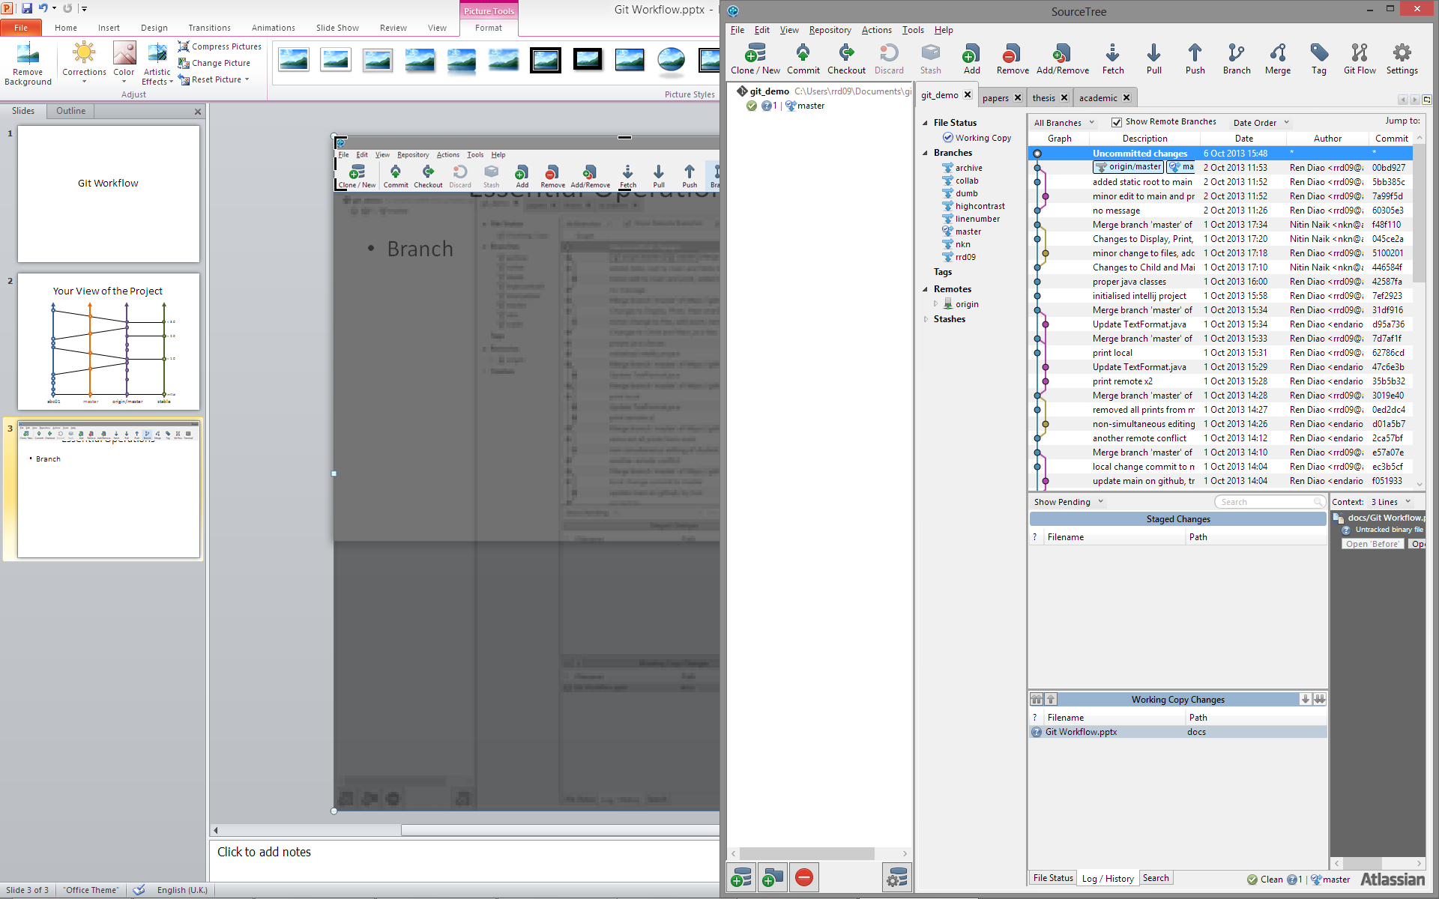
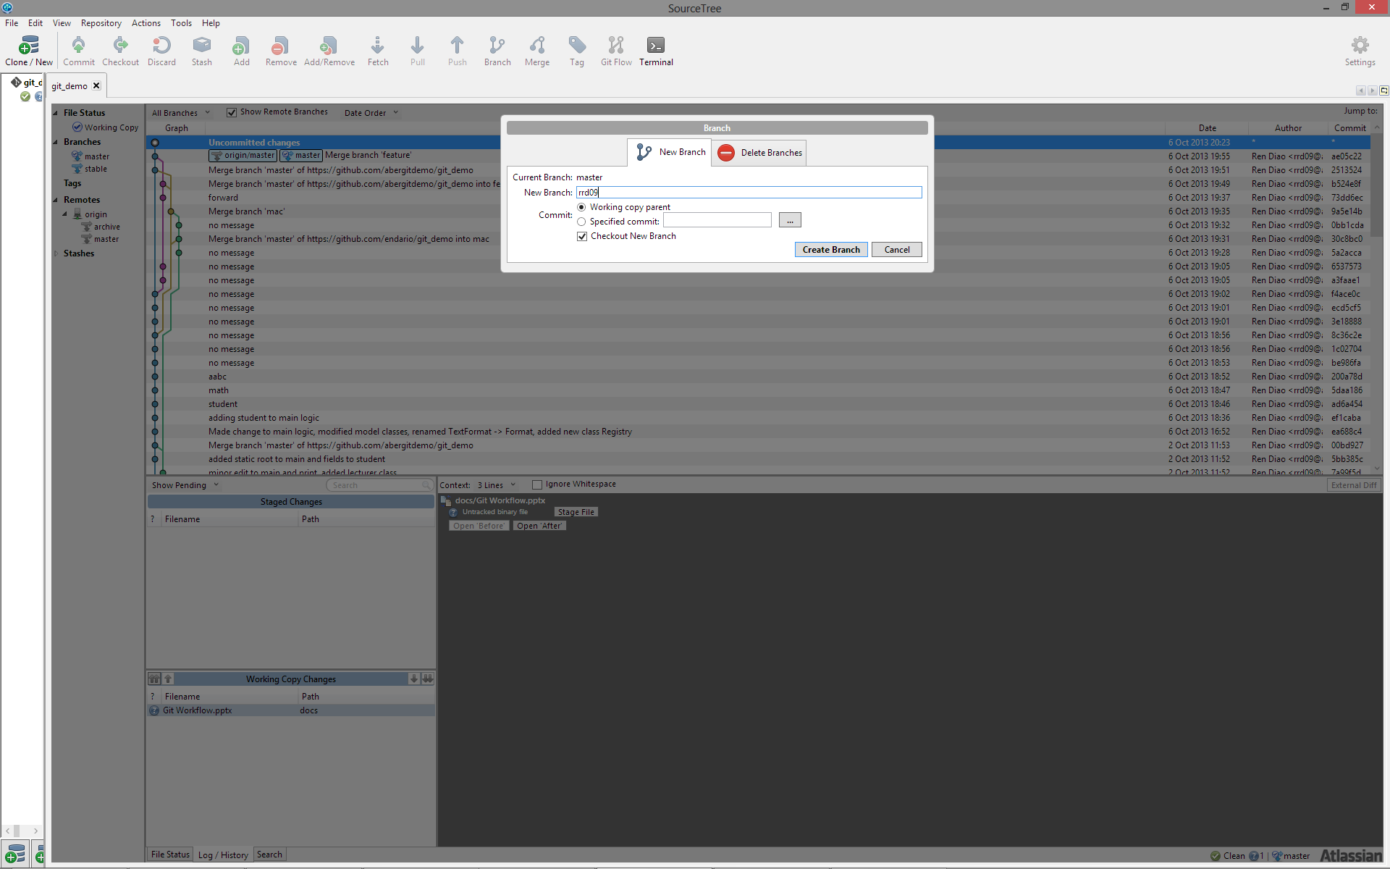
2. Create New Side Branch
Create (and switch to) a new side branch

Slide 9

3(a). Make Changes
None of Git’s business

Slide 10
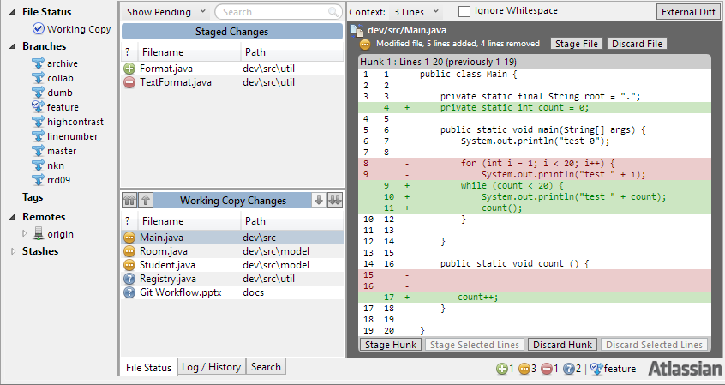
3(b). Stage Changes
Remember only stage the necessary changes

Slide 11
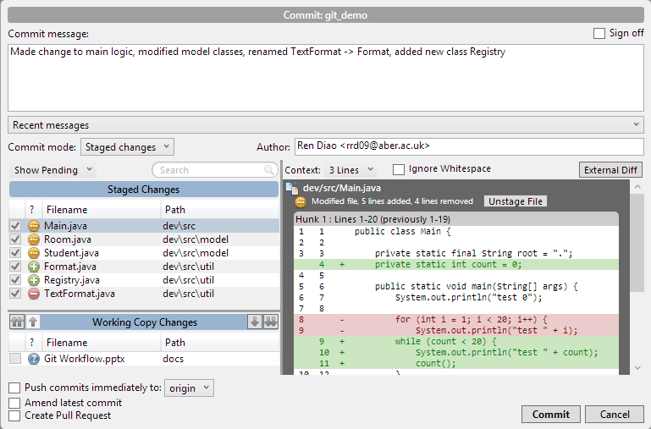
3(c).Commit Changes

Slide 12
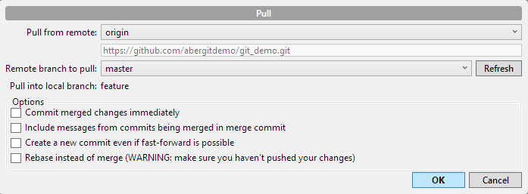
4. Keeping Up-to-Date* (while in a side branch)
Fetch & Pull origin/master into your branch
and resolve conflicts ... when necessary

Slide 13
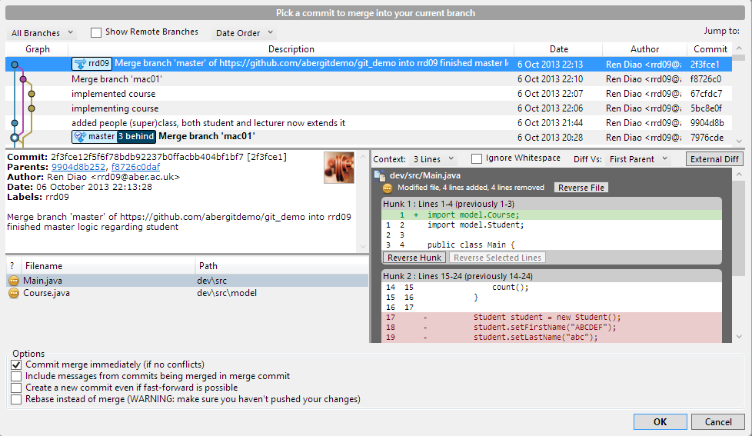
5. Merge Change into master (remember to switch to master first)
Switch to master branch

Slide 14
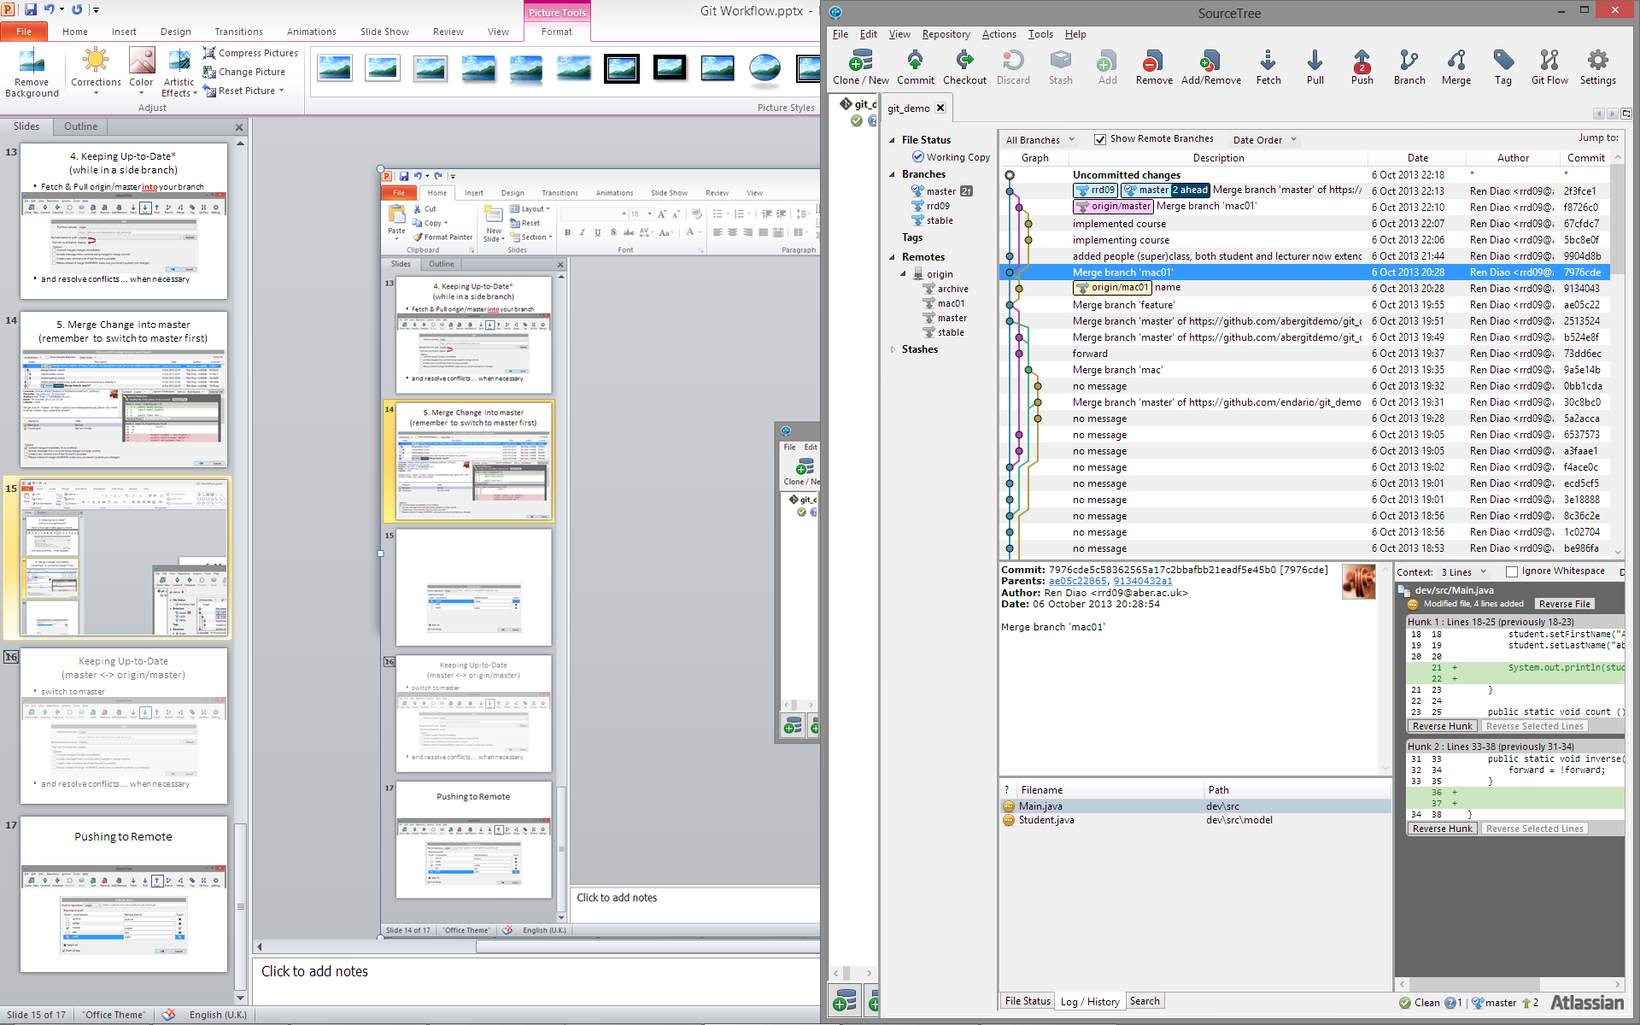
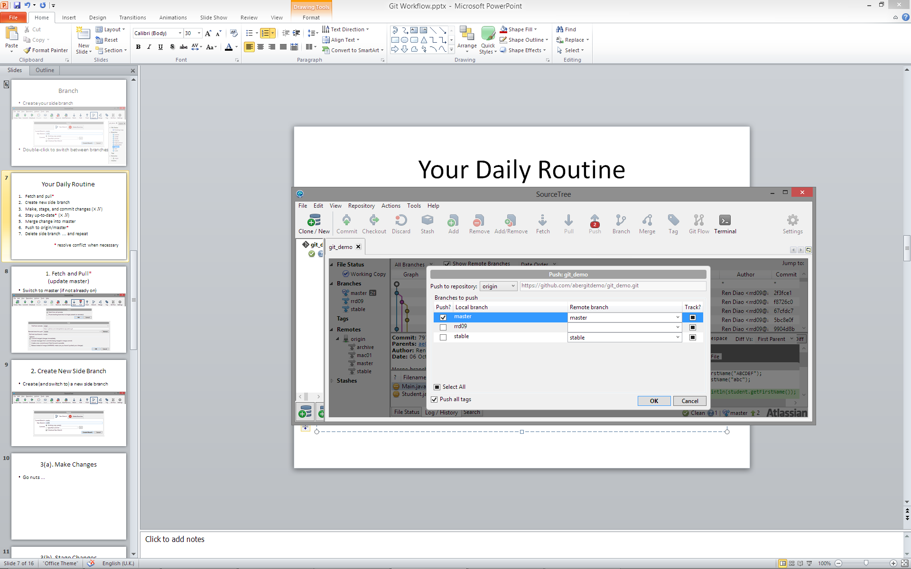
6. Push to origin/master*
If someone happens to push updates in between your steps 4 and 6, you may need to Pull again and deal with the potential merge conflicts

Slide 15
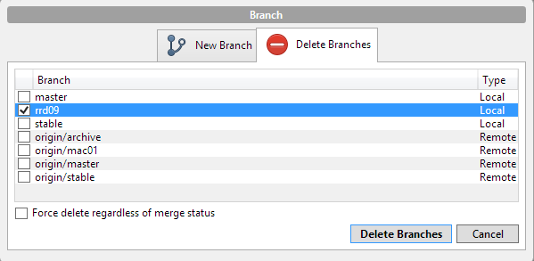
7. Delete side branch ... and repeat
Delete your local side branch if this particular line of development is completed
Rinse and repeat

Slide 16
Essential Operations
Branch
Stage and commit changes
Merge commits
Pull and push changes

Slide 17
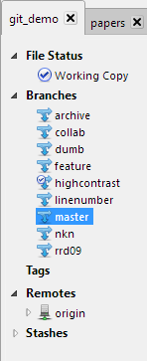
Branch
Create your side branch
Double-click to switch between branches

Slide 18
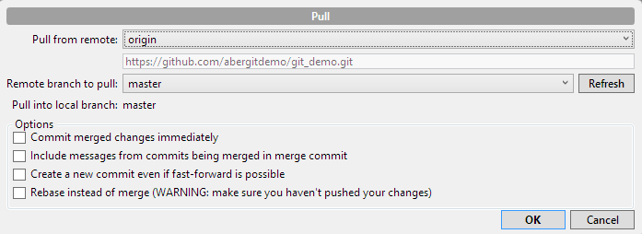
Keeping Up-to-Date (master <-> origin/master)
switch to master
and resolve conflicts ... when necessary

